Slide 2
MCCA
“You’ve Got This”
Public Relations Campaign
Pamela Cox-Otto, Ph.D. - Interact Communications
July 31, 2014

Slide 3
Public Relations
The “Original” Plan
Increase awareness and strengthen support among opinion leaders and voters on the role that the community colleges in Michigan play in the economic and social well being of the state.
Enlist and maintain the ongoing support of faculty, staff, and community opinion leaders in reinforcing core system messages.
Use the public relations campaign to reinforce the statewide branding message of “You’ve Got This.”

Slide 4
Fall Marketing
The Modified Plan
Implement a participating college and MCCA-based PR plan during Fall in service of community college image.
Continue to drive traffic to the website
Option: Develop an expanded news and fact section in the website for opinion leaders OR Youvegotthis.us or info
Examine the difference between Marketing and PR traffic for decision-making purposes.
Create a back area of the YGT site for PR story placement and as a staging area for home page placement.

Slide 5
Plan Constraints
The pooled state dollars are going into the state marketing buy, so this must be done at minimal cost.
Colleges and districts have core communication functions that draw their prime attention
Neither state nor district staff can ignore ongoing responsibilities to implement this plan
The plan must not raise a “red flag” for expenditures
This approach is not about “spin”, it is about “being” those attributes we promote
With the conglomeration of the media within the State of Michigan, media stories spread quickly, and colleges’ public relations “fates” are closely linked

Slide 6
Collaterals
Website Expansion for PR Purposes – In Process- Interact
Online College Media Kit – In Process - Interact
http://clients.interactcom.com/mcca/toolkit/
Messaging Playbook – TBD – Interact
Social Media Campaign – TBD – Interact/Colleges/MCCA
State Facebook/Google+
State YouTube
State Twitter
PR Story Ideas – In Process – Interact/Colleges

Slide 7
Collaterals To Be Determined
Interact and Colleges
Information Folders & Inserts
Posters
Postcards
All-College Viewbook
Brochures
Window clings
Bumper-Stickers

Slide 8
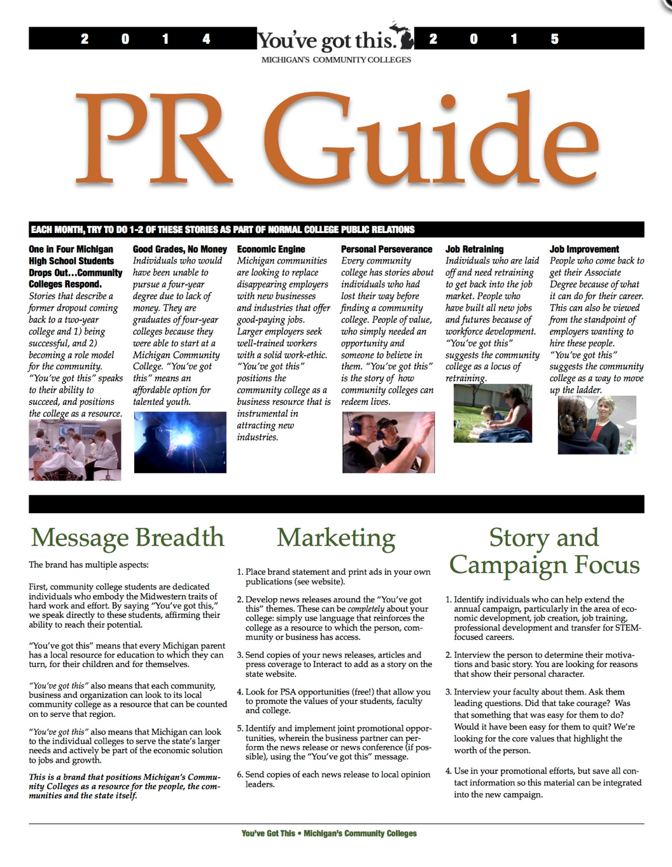
Media-Based Public Relations
Simple but with Potential
2 stories a month
Once during the Fall
Shared Coverage
Op Ed
PSA

Slide 9
Next Steps
Implementation of Promotion and PR elements this Fall
Track Efforts
Decision on Collaterals
Create Collaterals
Create/Expand website

Slide 10
interactcom.com youtube.com/interactcom facebook.com/interactcom twitter.com/interact

